Slide 1
Alternating Current

Slide 2
Alternating Current
Energy Sources
1800- Thomas Edison
Power stations at community level
1888- Nicola Tesla, rotating mag. fields & their potential for gene & transmission

Slide 3
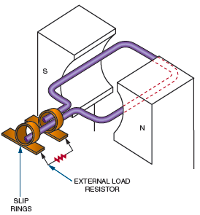
Generating Alternating Current
Figure 12-1A. Basic AC generator (alternator).

Slide 4
AC generator(also called ALTERNATOR) mech -> elec.
Principle of e.m. induction = Whenever a current carrying conductor is placed in a mag field, a voltage is induced in it.
Left- Hand Rule
Max. Voltage: Conductor is moved perpendicular to the magnetic field
No voltage: Parallel

Slide 5
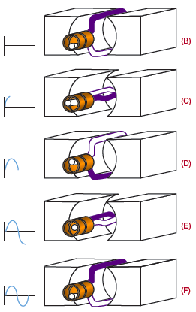
Figure 12-1B-F. AC generator inducing a voltage output.

Slide 6
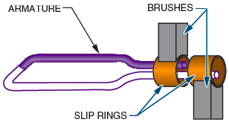
Generating Alternating Current (cont’d.)
Figure 12-3. Voltage is removed from the armature of an
AC generator through slip rings.

Slide 7
Each half cycle is called as an alteration
One cycle consists of two alterations
Rotating loop of wire is called as the ARMATURE
AC Generator should be made up of many loops

Slide 8
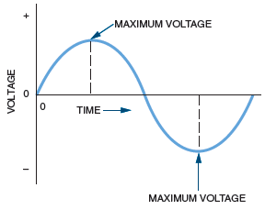
AC GENERATOR→ SINE WAVE
Figure 12-4. The sinusoidal waveform, the most basic of the AC waveforms.

Slide 9
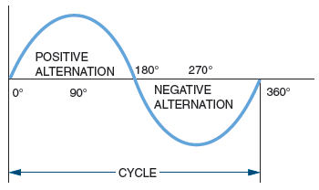
Generating Alternating Current (cont’d.)
Figure 12-2. Each cycle consists of a positive and a negative alternation.

Slide 10
AC Values
Each point on AC Waveform has a pair of nos.
1st Value-Degree of rotation: Angle to which armature has turned
2nd Value-indicate its amplitude
---There are several methods to express these values
Peak value: Absolute value of the point with the greatest amplitude. – positive peak
-- negative peak
Peak to Peak value: Vertical distance b/w 2 peaks.

Slide 11
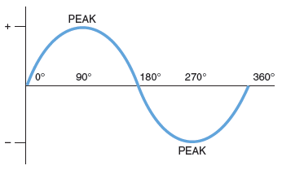
Figure 12-5. The peak value of a sine wave is the point on the AC waveform having the greatest amplitude. The peak value occurs
during both the positive and the negative alternations of the waveform.

Slide 12
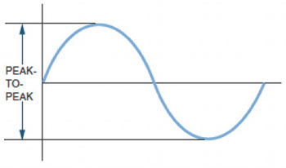
AC Values (cont’d.)
Figure 12-6. The peak-to-peak value can be determined by adding the peak values of the two alternations.

Slide 13
AC Values (cont’d.)
Effective value of a sine wave:
  E_{rms} = 0.707E_{p}
    where: E_{rms} = rms or effective voltage value
        E_{p} = maximum voltage of one alternation
  I_{rms} = 0.707I_{p}
    where: I_{rms} = rms or effective current value
    I_{p} = maximum current of one alternation

Slide 14
AC Values (cont’d.)
Period: Time reqd to complete 1 cycle.
Frequency: No. of cycles in per sec.
Relationship between frequency and period:
  f = 1/t
  t = 1/f
  where: f = frequency
  t = period

Slide 15
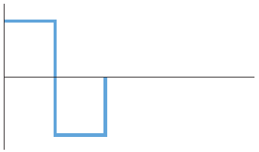
Nonsinusoidal Waveforms
I/V immediately reaches its max value & stays there.
Pulse width: One-half period. Or, Duration the V is at max value until it drops to min value.
Figure 12-7. Square waveform.

Slide 16
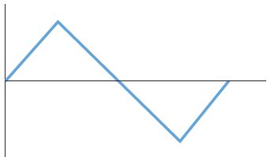
Nonsinusoidal Waveforms (cont’d.)
Figure 12-8. Triangular waveform.
Period- from peak to peak

Slide 17
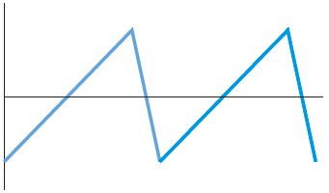
Nonsinusoidal Waveforms (cont’d.)
Sawtoothed Waveform: rich in harmonics. Used for music synthesizers and musicians to give the quality of the sound or tonal colour to their music without any distortion.
Figure 12-9. Sawtooth waveform.

Slide 18
Non sinusoidal wave = Fundamental freq + harmonics
Fundamental freq: repetition rate of waveform
Harmonics: Higher freq sine wave that are exact multiple of f.f.
Odd harmonics: Freq that are odd multiples of f.f.
Even harmonics: Freq that are even multiples of f.f.

Slide 19
Square: f.f + odd harminics
Triangular: f.f + all odd harmonics (180 out of phase with f.f.)
Sawtooth: Both even + odd harmonics.
(even harmonics are 180 out of phase with the odd harmonics)

Slide 20
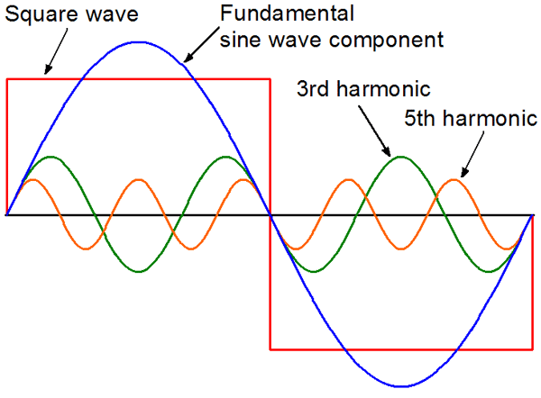
Square Wave

Slide 21

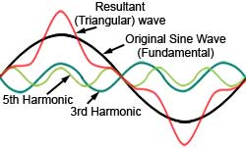
Triangular Wave

